Slide 1
C Functions

Slide 2
Introduction
Divide and conquer
Construct a program from smaller pieces or components
These smaller pieces are called modules
Each piece more manageable than the original program

Slide 3
Program Modules in C
Functions
Modules in C
Programs combine user-defined functions with library functions
C standard library has a wide variety of functions
Function calls
Invoking functions
Provide function name and arguments (data)
Function performs operations or manipulations
Function returns results

Slide 4
Types of functions in C programming
There are two types of functions in C programming:
Standard library functions
User defined functions

Slide 5
Standard library functions
Math library functions
perform common mathematical calculations
#include <math.h>
Format for calling functions
FunctionName( argument );
printf( "%.2f", sqrt( 900.0 ) );

Slide 6
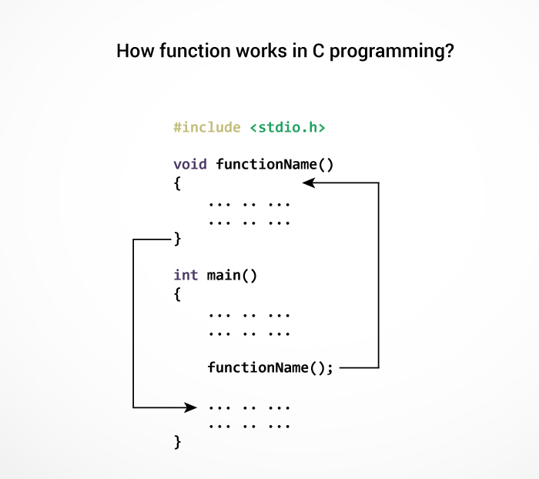
User-defined functions
C allow programmers to define functions. Such functions created by the user are called user-defined functions.

Slide 7
#include <stdio.h>
int addNumbers(int a, int b); // function prototype
int main()
{
int n1,n2,sum;
printf("Enters two numbers: ");
scanf("%d %d",&n1,&n2);
sum = addNumbers(n1, n2); // function call
printf("sum = %d",sum);
return 0;
}
int addNumbers(int a,int b) // function definition
{
int result;
result = a+b;
return result; // return statement
}

Slide 8
Syntax of function prototype
returnType functionName(type1 argument1, type2 argument2,...);
Syntax of function call
functionName(argument1, argument2, ...);
Syntax of function definition
returnType functionName(type1 argument1, type2 argument2, ...)
{
//body of the function
}

Slide 9
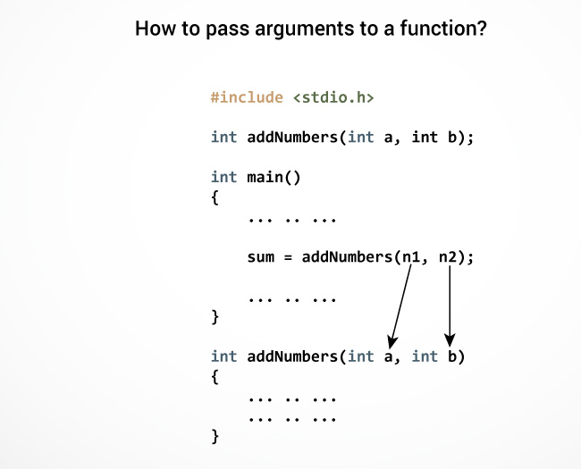

Slide 10
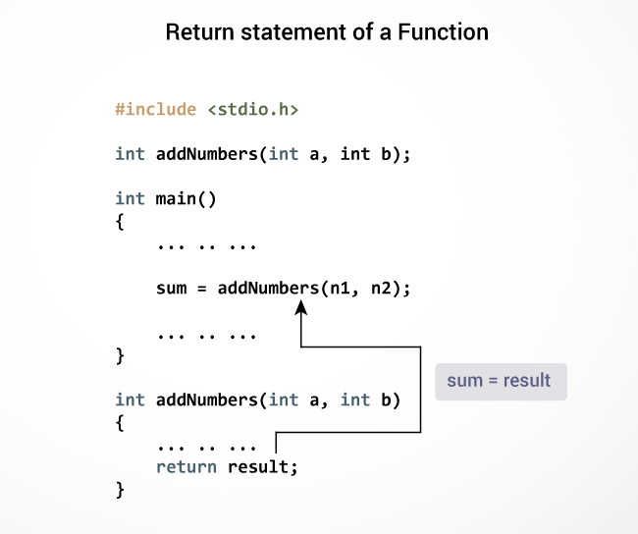

Slide 11
Types of User-defined Functions in C Programming
Function with no arguments and no return value
Function with no arguments and a return value
Function with arguments and no return value
Function with arguments and a return value.

Slide 12
Function with no arguments and no return value
#include <stdio.h>
void checkPrimeNumber();
int main()
{
checkPrimeNumber(); // no argument is passed to prime()
return 0;
}
// return type of the function is void becuase no value is returned from the function
void checkPrimeNumber()
{
int n, i, flag=0;
printf("Enter a positive integer: ");
scanf("%d",&n);
for(i=2; i <= n/2; ++i)
{
if(n%i == 0)
{
flag = 1;
}
}
if (flag == 1)
printf("%d is not a prime number.", n);
else
printf("%d is a prime number.", n);
}

Slide 13
Function with no arguments and a return value
#include <stdio.h>
int getInteger();
int main()
{
int n, i, flag = 0;
// no argument is passed to the function
// the value returned from the function is assigned to n
n = getInteger();
for(i=2; i<=n/2; ++i)
{
if(n%i==0)
{
flag = 1;
break;
}
}
if (flag == 1)
printf("%d is not a prime number.", n);
else
printf("%d is a prime number.", n);
return 0;
}
// getInteger() function returns integer entered by the user
int getInteger()
{
int n;
printf("Enter a positive integer: ");
scanf("%d",&n);
return n;
}

Slide 14
Function with arguments and no return value
// void indicates that no value is returned from the function
void checkPrimeAndDisplay(int n)
{
int i, flag = 0;
for(i=2; i <= n/2; ++i)
{
if(n%i == 0){
flag = 1;
break;
}
}
if(flag == 1)
printf("%d is not a prime number.",n);
else
printf("%d is a prime number.", n);
}
#include <stdio.h>
void checkPrimeAndDisplay(int n);
int main()
{
int n;
printf("Enter a positive integer: ");
scanf("%d",&n);
// n is passed to the function
checkPrimeAndDisplay(n);
return 0;
}

Slide 15
Function with arguments and a return value
#include <stdio.h>
int checkPrimeNumber(int n);
int main()
{
int n, flag;
printf("Enter a positive integer: ");
scanf("%d",&n);
// n is passed to the checkPrimeNumber() function
// the value returned from the function is assigned to flag variable
flag = checkPrimeNumber(n);
if(flag==1)
printf("%d is not a prime number",n);
else
printf("%d is a prime number",n);
return 0;
}
// integer is returned from the function
int checkPrimeNumber(int n)
{
/* Integer value is returned from function checkPrimeNumber() */
int i;
for(i=2; i <= n/2; ++i)
{
if(n%i == 0)
return 1;
}
return 0;
}

Slide 16
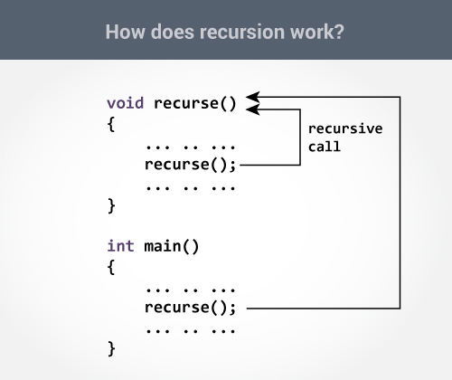
Recursion
A function that calls itself is known as a recursive function. And, this technique is known as recursion.

Slide 17
Recursion example
#include <stdio.h>
int sum(int n);
int main()
{
int number, result;
printf("Enter a positive integer: ");
scanf("%d", &number);
result = sum(number);
printf("sum=%d", result);
}
int sum(int num)
{
if (num!=0)
return num + sum(num-1); // sum() function calls itself
else
return num;
}

Slide 18
Scope Rules
Inside a function or a block which is called local variables.
Outside of all functions which is called global variables.

Slide 19
#include <stdio.h>
int main ()
{
/* local variable declaration */
int a, b;
int c;
/* actual initialization */
a = 10;
b = 20;
c = a + b;
printf ("value of a = %d, b = %d and c = %d\n", a, b, c);
return 0;
}

Slide 20
#include <stdio.h>
/* global variable declaration */
int g = 20;
int main ()
{
/* local variable declaration */
int g = 10;
printf ("value of g = %d\n", g);
return 0;
}

Slide 21
Passing Arrays as Function Arguments
#include <stdio.h>
/* function declaration */
double getAverage(int arr[], int size);
int main () {
/* an int array with 5 elements */
int balance[5] = {1000, 2, 3, 17, 50};
double avg;
/* pass pointer to the array as an argument */
avg = getAverage( balance, 5 ) ;
/* output the returned value */
printf( "Average value is: %f ", avg );
return 0;
}
double getAverage(int arr[], int size) {
int i;
double avg;
double sum = 0;
for (i = 0; i < size; ++i) {
sum += arr[i];
}
avg = sum / size;
return avg;
}

Slide 22
5.11 Storage Classes
Storage class specifiers
Storage duration – how long an object exists in memory
Scope – where object can be referenced in program
Linkage – specifies the files in which an identifier is known (more in Chapter 14)
Automatic storage
Object created and destroyed within its block
auto: default for local variables
auto double x, y;
register: tries to put variable into high-speed registers
Can only be used for automatic variables
register int counter = 1;

Slide 23
5.11 Storage Classes
Static storage
Variables exist for entire program execution
Default value of zero
static: local variables defined in functions.
Keep value after function ends
Only known in their own function
extern: default for global variables and functions
Known in any function

